Slide 1
Implementation Science in HIV
Sarah M. Wilson, Ph.D.
Assistant Professor
Duke School of Medicine
Department of Psychiatry & Behavioral Sciences
Department of Population Health Sciences
July 5, 2023

Slide 2
Why Now?
Antiretroviral therapy is highly efficacious
PrEP is highly efficacious
U=U (Undetectable = Untransmittable)
Vaccine and cure research is moving forward
And yet…
Notes:
We know how to treat HIV
We know how to prevent new infections
Disparities in new HIV infections are getting worse.

Slide 3
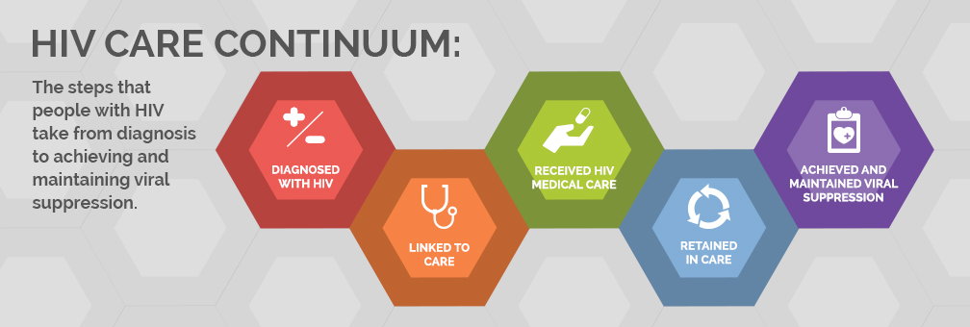
HIV Care Continuum

Slide 4
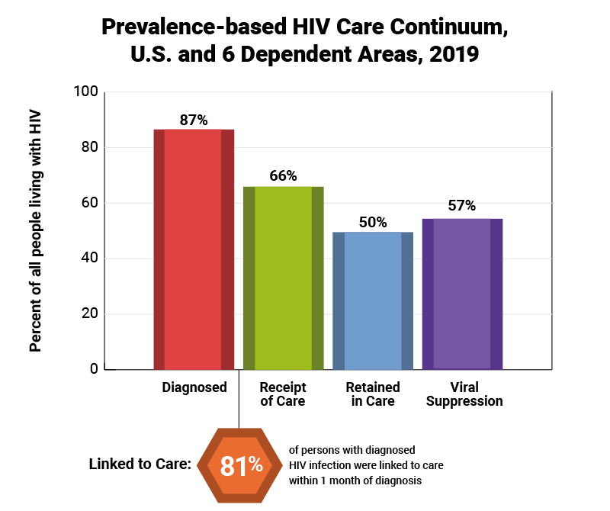
U.S. Prevalence-Based HIV Care Continuum, 2019

Slide 5
The “gap between research and implementation is impeding success in prevention, care, and treatment programs in the number of people reached and effects on health outcomes.”
- NIMH HIV Prevention and Treatment Implementation Science Program
Notes:
“This program encourages research to enhance the uptake, effectiveness and efficiency of evidence-based interventions, and to inform and enhance the effectiveness and efficiency of interventions currently available in the continuum of HIV prevention, HIV testing, and HIV care, to maximize community impact.
“Significant progress is needed to transfer interventions from one setting or population to another, and to make informed choices between competing interventions to maximize their effect in target populations. This gap between research and implementation is impeding success in prevention, care, and treatment programs in the number of people reached and effects on health outcomes.
“Advances are urgently needed to reduce these unknowns and increase the public health impact of HIV/AIDS prevention, treatment, and care services.”

Slide 6
What is Implementation Science?
And what isn’t implementation science?
And why do we need implementation science?

Slide 7
What is Implementation Science?
And why do you need it?

Slide 8
When Defining Implementation Science, Some Very Non-Scientific Language Can Be Useful:
The healthcare intervention/practice/innovation is THE THING.
Efficacy research looks at whether THE THING works under highly controlled circumstances.
Effectiveness research looks at whether THE THING works in real-life circumstances.
Implementation research looks at how best to help people/places DO THE THING.
Implementation strategies are the stuff we do to try to help people/places DO THE THING.
Main implementation outcomes are how much and how well they DO THE THING.

Slide 9
Interactive Activity
Brainstorm “THINGS” HIV testing, prevention, and clinical care that you think could be done more often or more consistently by clinicians, clinics, public health officials, non-profit organizations, and/or other clinical staff.
Write as many ideas as you can in 2 minutes.

Slide 10
Implementation Frameworks:
The Key to Starting Out
Always use an implementation science framework, theory, or model to guide your research question(s) and design.
Most common frameworks/theories used in NIH-funded HIV-related implementation research (Smith et al., 2020):
  ADAPT-ITT
  Consolidated Framework for Implementation Research (CFIR)
  RE-AIM
  PRECEDE-PROCEED
Other honorable mentions:
  EPIS
  Health Equity Implementation Framework

Slide 11
ADAPT-ITT Model
Assessment
Decision
Adaptation
Production
Topical experts
Integration
Training
Testing
Notes:
Assessment
Obtain a better understanding of the target population, such as the perceived need for prevention, risk profile and preferences for intervention content and delivery. Uses focus groups or interviews as evaluation methods.
Decision
Select interventions while considering factors such as:
Outcomes
Demographics
Behavioural and psychosocial risks
Content, delivery and capacity to implement, resources
Make a decision whether to adopt or adapt the intervention.
Adaptation
Use a pretesting methodology known as theatre testing to better understand how to adapt the intervention and determine refinements related to content, delivery style and materials that may need to be made.
Production
Create adaptation plan and determine goals.
Determine whether goals are to successfully adapt an EBI or to test whether the adapted EBI produces changes in theoretically important mediators and behavioural outcomes.
Produce draft 1 of the EBI considering the core elements to the original EBI, the capacity to modify and implement the adapted EBI, resources and support from key stakeholders, and the results of pretesting and assessment.
Topical experts
Provide substantive content and technical assistance.
Integration
Produce draft 2: combination of draft 1 content with expert-based content.
Produce draft 3: incorporate readability testing.
Training
Train all relevant personnel as facilitators, recruiters, assessors and in data management.
Testing
Pilot test with approximately 20 participants to assess "adaptation efficacy."
Second testing phase: perform a randomized study to ascertain the short-term efficacy of the adapted EBI (approx. 3 month time period, outcomes: change in knowledge, attitudes, beliefs and relevant behavioural outcomes).
Key characteristics of the intervention can be adapted, but core elements should be upheld and are implicated in the effectiveness of the intervention.

Slide 12
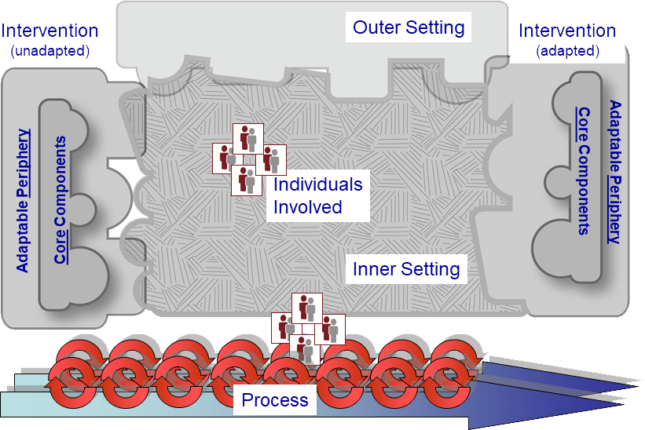
Consolidated Framework for Implementation Research (CFIR)
Website: https://cfirguide.org/
  Construct definitions
  Interview guides
  Survey design
  Implementation outcomes
  Implementation strategy matching tool
Notes:
Assessment
Obtain a better understanding of the target population, such as the perceived need for prevention, risk profile and preferences for intervention content and delivery. Uses focus groups or interviews as evaluation methods.
Decision
Select interventions while considering factors such as:
Outcomes
Demographics
Behavioural and psychosocial risks
Content, delivery and capacity to implement, resources
Make a decision whether to adopt or adapt the intervention.
Adaptation
Use a pretesting methodology known as theatre testing to better understand how to adapt the intervention and determine refinements related to content, delivery style and materials that may need to be made.
Production
Create adaptation plan and determine goals.
Determine whether goals are to successfully adapt an EBI or to test whether the adapted EBI produces changes in theoretically important mediators and behavioural outcomes.
Produce draft 1 of the EBI considering the core elements to the original EBI, the capacity to modify and implement the adapted EBI, resources and support from key stakeholders, and the results of pretesting and assessment.
Topical experts
Provide substantive content and technical assistance.
Integration
Produce draft 2: combination of draft 1 content with expert-based content.
Produce draft 3: incorporate readability testing.
Training
Train all relevant personnel as facilitators, recruiters, assessors and in data management.
Testing
Pilot test with approximately 20 participants to assess "adaptation efficacy."
Second testing phase: perform a randomized study to ascertain the short-term efficacy of the adapted EBI (approx. 3 month time period, outcomes: change in knowledge, attitudes, beliefs and relevant behavioural outcomes).
Key characteristics of the intervention can be adapted, but core elements should be upheld and are implicated in the effectiveness of the intervention.

Slide 13
RE-AIM Framework
Reach the target population
Effectiveness or efficacy
Adoption by target staff, settings, or institutions
Implementation consistency, costs and adaptions made during delivery
Maintenance of intervention effects in individuals and settings over time
Website: https://www.re-aim.org/
  Construct definitions
  Publications using RE-AIM
  Example outcome measures
  Interview guide sample
  RE-AIM online training

Slide 14
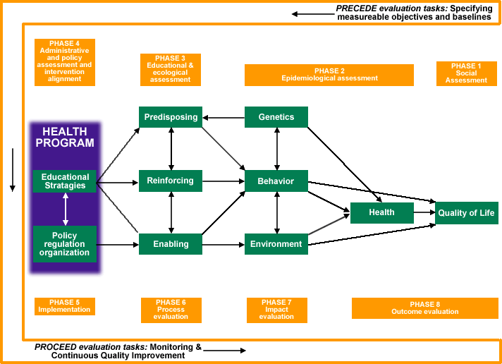
PRECEDE-PROCEED MODEL
Website: https://ctb.ku.edu/en/table-contents/overview/other-models-promoting-community-health-and-development/preceder-proceder/main

Slide 15
Example from my work

Slide 16
Project Goal

Slide 17
Partnership with Latinos in the South Program

Slide 18
Let’s Discuss the Project using
Very Non-Scientific Language:
THE THING: Pre-Exposure Prophylaxis (PrEP) for HIV.
Efficacy: PrEP works.
Effectiveness: PrEP works in real-life circumstances.
Implementation: “DOING THE THING” is lagging, especially for Black and Latinx populations.
Implementation Strategies: We need “stuff” to try to help people/places DO THE THING.
Implementation Outcomes: We need to better measure how much and how well people/places DO THE THING for Black and Latinx individuals.
Notes:
THE THING: Pre-Exposure Prophylaxis (PrEP) for HIV.
Efficacy of THE THING (PrEP) has been established. It works.
Effectiveness of THE THING has been established. It works in real-life circumstances.
Implementation of THE THING is lagging. Healthcare, Government, and Non-Profit Organizations aren’t DOING THE THING in a way that works for Black and Latinx individuals. We do not know how best to help people/places DO THE THING in a way that works for Black and Latinx individuals.
We need “stuff” to try to help people/places DO THE THING.
We need to also better measure how much and how well people/places DO THE THING.

Slide 19
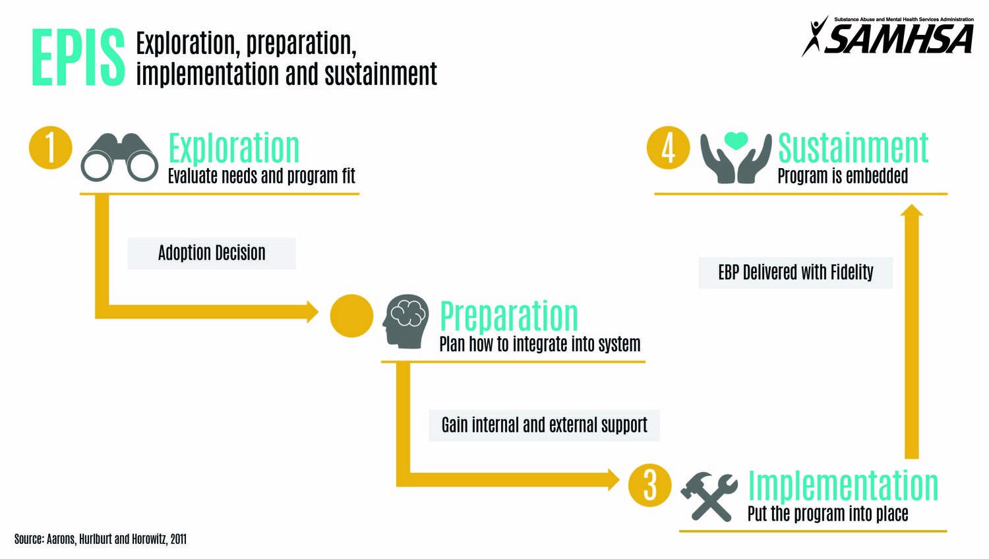
Framework for the Project: EPIS
Notes:
EXPLORATION
In the Exploration phase, a service system, organization, research group, or other stakeholder(s) consider the emergent or existing health needs of the patients, clients, or communities and work to identify the best EBP(s) to address those needs, and subsequently decides whether to adopt the identified EBP. In addition, consideration is given to what might need to be adapted - at the system, organization, and/or individual level(s), and to the EBP itself.
PREPARATION
In the Preparation phase, the primary objectives are to identify potential barriers and facilitators of implementation at the outer and inner contexts (described later), further assess needs for adaptation, and to develop a detailed plan to capitalize on implementation facilitators and address potential barriers. Critical within the Preparation phase is planning of implementation supports (e.g., coaching, audit and feedback) to facilitate use of the EBP in the next two phases (Implementation and Sustainment) and consideration of how best to develop an implementation climate that indicates that EBP use is expected, supported, and rewarded in the system and organization
IMPLEMENTATION
In the Implementation phase and guided by the planned implementation supports from the Preparation phase, EBP use is initiated and instantiated in the system and/or organization(s). However, it is essential that ongoing monitoring of the implementation process is incorporated to assess how it is proceeding and to support efforts to adjust accordingly.
SUSTAINMENT
In the Sustainment phase, the outer and inner context structures, processes, and supports are ongoing so that the EBP continues to be delivered, with or without some adaptation, to realize the resulting public health impact of the implemented EBP.

Slide 20
Additional CBPR Power-Sharing Framework Elements

Slide 21
Key Questions within the Work

Slide 22
Collaborators

Slide 23
Methodology:
Power-Sharing in Implementation Mapping

Slide 24
Implementation Outcomes:
Your Work is Only as Good as Your Measures
Remember: Main implementation outcomes are how much and how well they DO THE THING.

Slide 25
Implementation Outcomes
Acceptability (e.g., How acceptable is to clinicians to prescribe PrEP?)
Adoption (e.g., What proportion of clinicians plan to prescribe PrEP?)
Appropriateness (e.g., How do stakeholders view the compatibility of PrEP prescribing with the structure/ethos/culture of the clinic or service organization?)
Costs (e.g., How much will it cost to train and remind clinicians about PrEP prescribing?)

Slide 26
Implementation Outcomes
Feasibility (e.g., How feasible will it be to train and remind clinic staff to offer PrEP?)
Fidelity (e.g., How well did clinicians adhere to principles of motivational interviewing when offering PrEP?)
Penetration (e.g., What percentage of patients who were appropriate for PrEP were offered the medication?)
Sustainability (e.g., What are health system leadership perceptions of the future of PrEP in the clinic?)

Slide 27


More Resources
Inter-CFAR Implementation Science Resources
https://www.thirdcoastcfar.org/implementation-science/
JAIDS Supplement on Implementation Science
https://journals.lww.com/jaids/toc/2019/12003

